Slide 1

AI Academic Advisor
Empowering Students with AI-Driven Insights!

Slide 2

AI Academic Advisor
Personalized Recommendations
Smart Study Plans
Optimized learning and career progression through personalized study plans.
Tailored course suggestions based on academic performance, preferences, and career interests.
Guided Career Advice
Potential career paths suggested based on field of study and interests, enabling informed decisions.

Slide 3



Meet Our Team
Abhishek Sukhadiya
Akshay Patel
Dhaval Desai
Backend Expertise
Frontend Expertise
Data Analysis & QA

Slide 4
Team Roles
Abhishek Sukhadiya
Akshay Patel
Dhaval Desai
Backend & Database Design
Frontend & UI/UX Design
Testing & Quality Assurance
Backend Development
System Architecture
Data Analysis

Slide 5
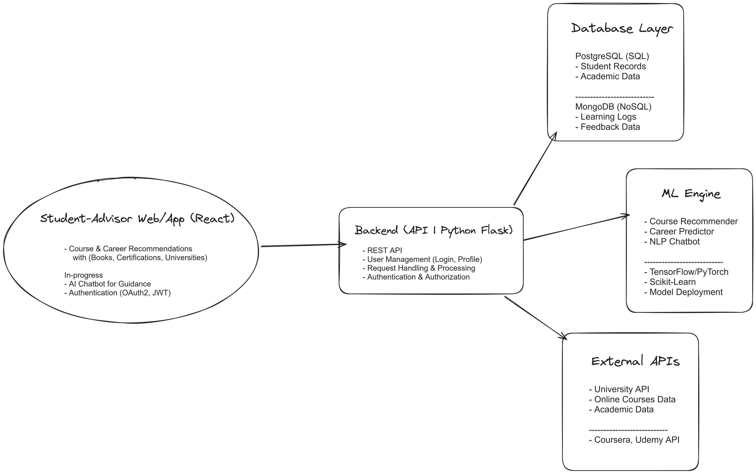
System Design (High level)

Slide 6
Current State
Recommendation systems
Content-Based Filtering: academic performance, preferences, and past achievements
Collaborative Filtering: analyzing patterns and preferences from similar users, fostering shared insights
Knowledge-Based Recommendations: academic and career-related data to make connections that are logical and rooted in expertise.
Ethical AI considerations
Bias Mitigation
Ethical Framework

Slide 7
Front-End Filtering Improvements
Challenges Encountered:
Difficulties: filtering precision, responsiveness, or performance issues.
Solutions Implemented:
Discuss optimized algorithms for advanced filtering (e.g., multi-level filtering based on course relevance or engagement metrics).
Share examples of improved UI elements ensuring a seamless user experience.
Showcase key metrics demonstrating enhanced accuracy and usability.

Slide 8
Database Scalability Enhancements
Scalability Bottlenecks:
Describe issues, like query performance for large datasets or real-time data handling limitations.
Solutions Implemented:
Present schema optimizations made in PostgreSQL, such as indexing, partitioning, or caching.
Highlight MongoDB enhancements (e.g., sharding or query refinement for NoSQL efficiency).
Include diagrams or flowcharts showcasing the updated architecture.
Results Achieved: Share statistics, like improved response times, increased capacity, or cost efficiency.

Slide 9
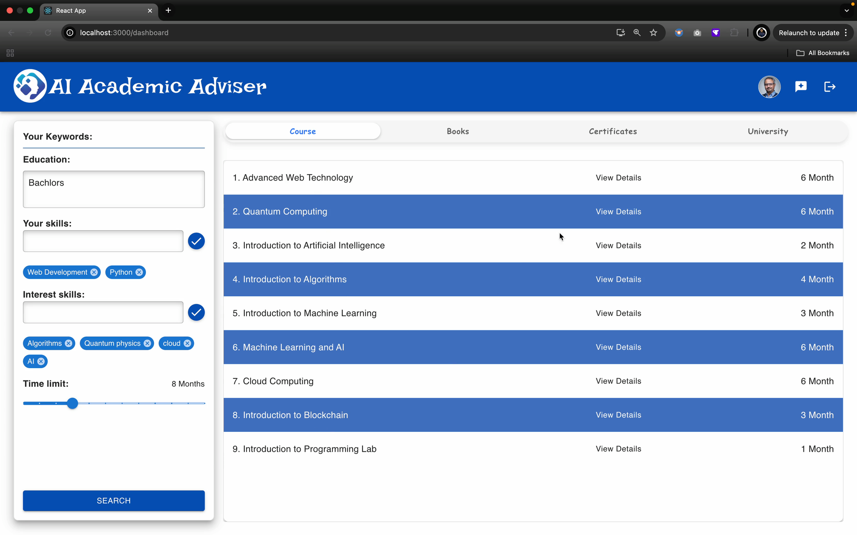
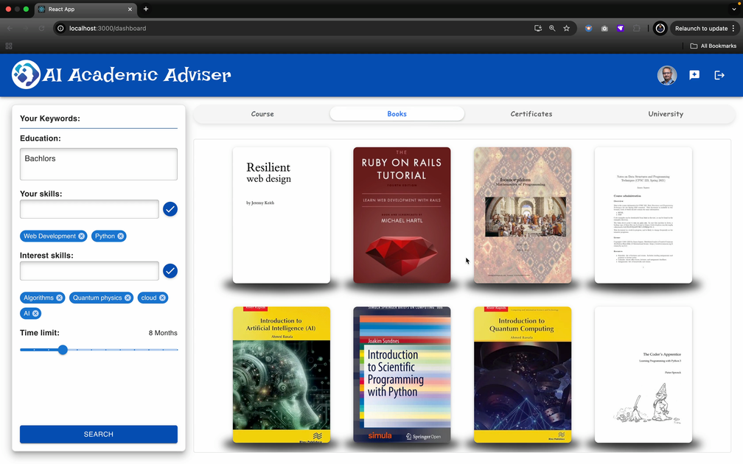
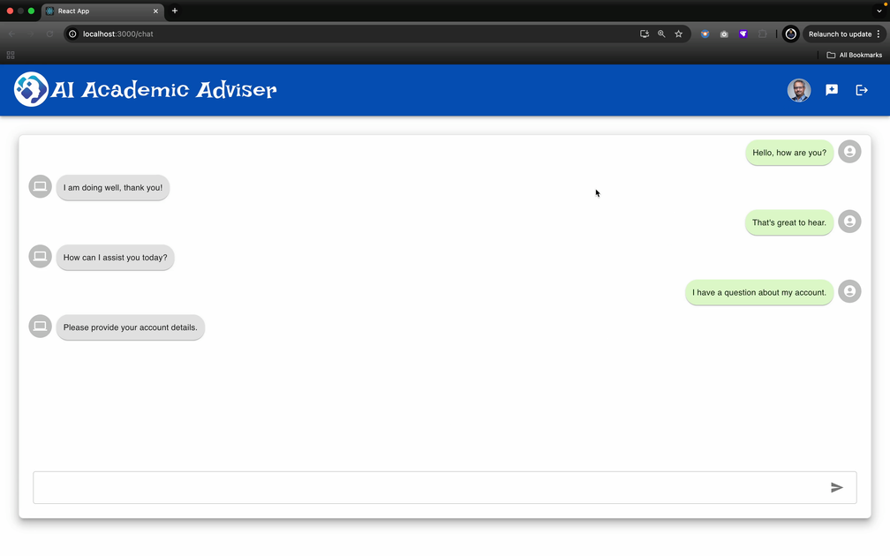
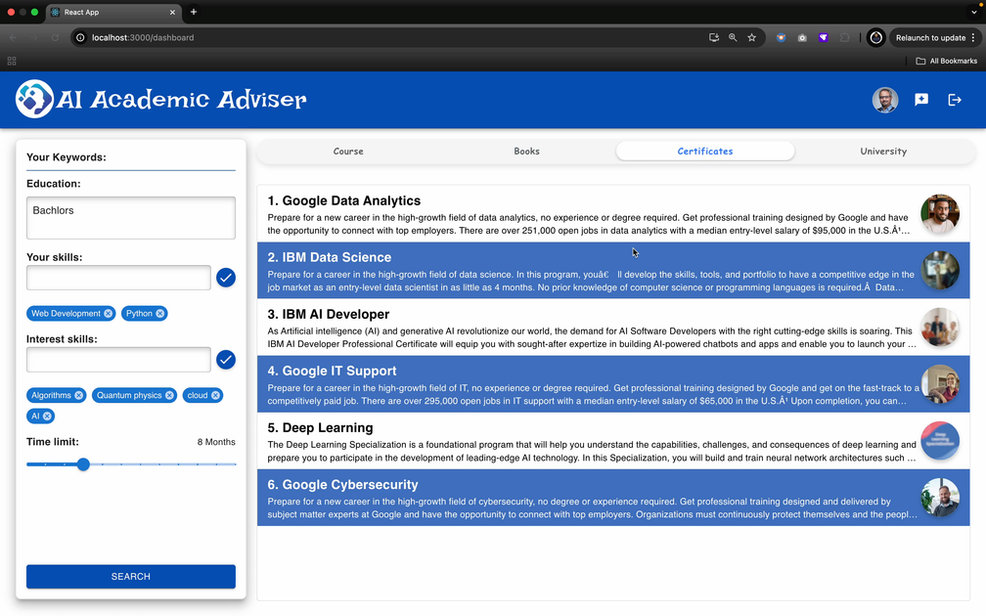
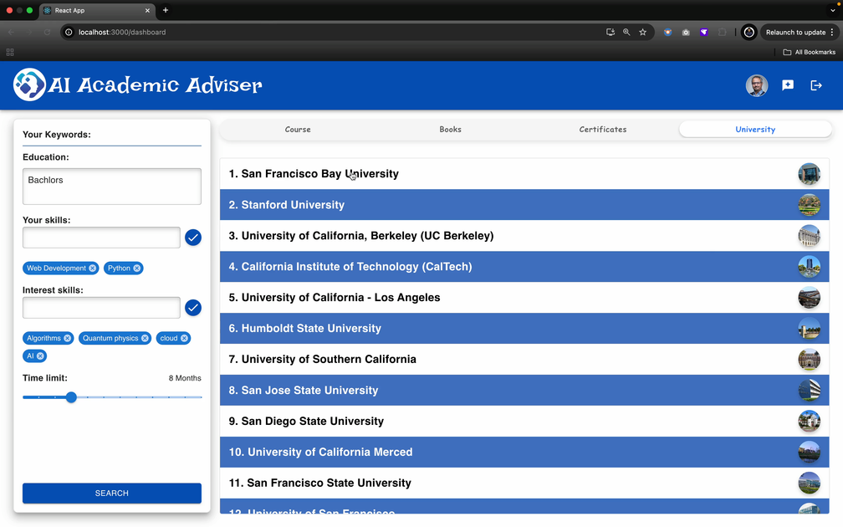
Frontend (views)

Slide 11
Testing, Data Analysis & Challenges
Testing:
Unit, integration, and system tests ensure accuracy in recommendations and frontend filtering.
Performance validated for response times and error rates in real-world scenarios.
Data Analysis:
Engagement metrics: user preferences, search queries, and recommendation success.
Visualizations reveal patterns using tools like Tableau/Matplotlib.
Challenges:
Technical: Query performance and scalability for real-time recommendations.
Operational: Mitigating bias and ensuring ethical AI.

Slide 12
What’s next? (Impact and Vision)
Enhance student engagement through tailored learning paths and career advice
Provide educators with actionable insights to improve academic practical experiences
Foster institutional innovation by leveraging AI to address systemic challenges in education

Slide 13
Timeline
Week 13 (Present)
Finalizing front-end filtering
Improving the database for scalability.
Week 15:
Completing corrections, model fine-tuning, and system deployment.

Slide 14
References
Data Sources:
Academic datasets
Coursera and Udemy APIs
Kaggle resources
Technical Frameworks:
React
Python Flask
TensorFlow and PyTorch
MongoDB, PostgreSQL

Slide 15
Thank You!

